Slide 1
ABAP Dictionary

Slide 2
Introduction to ABAP Dictionary
ABAP Dictionary is also called as Data Dictionary or DDIC.
The transaction code for data dictionary is SE11.

Slide 3
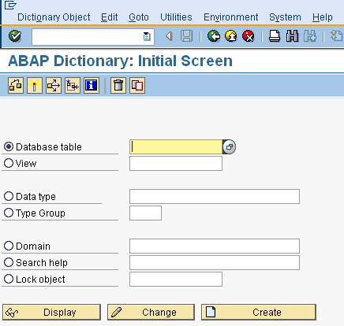
ABAP Dictionary Objects
Database table
View
Data type - Data Element , Structure, Table type
Type Group
Domain
Search Help
Lock Object
Data Dictionary Objects : SE11

Slide 4
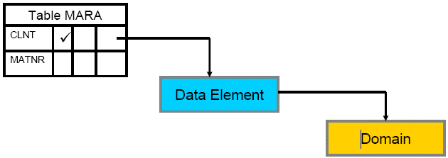
Domain
Domain describes the technical attributes
of a field/column.
Technical attributes means data type and length.
Domains are linked to fields via data elements.
Domain Link to Field via Data Element

Slide 5
Data Element
Data element describes the appearance of a field/column to end user.
It is used to provide a meaningful description to a field.

Slide 6
Table
Table is a collection of rows and columns.
Tables are containers which stores data in the form of record.
Table must have a primary key which is used to identify a record uniquely.

Slide 7
Client Dependent and Client Independent tables
Tables having MANDT field are called as client dependent or client specific tables.
Tables without MANDT field are called as client independent tables.
MANDT represents the client number of SAP system.

Slide 8
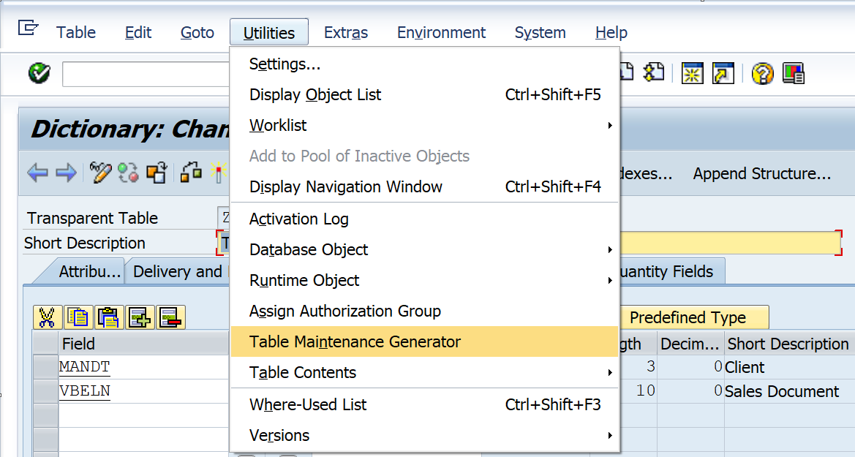
Table Maintenance Generator
It is also abbreviated as TMG.
TMG is used to maintain(insert, update ,delete)
data into tables.
We can generate the TMG through
SE11 transaction code.
Table Maintenance Generator

Slide 9
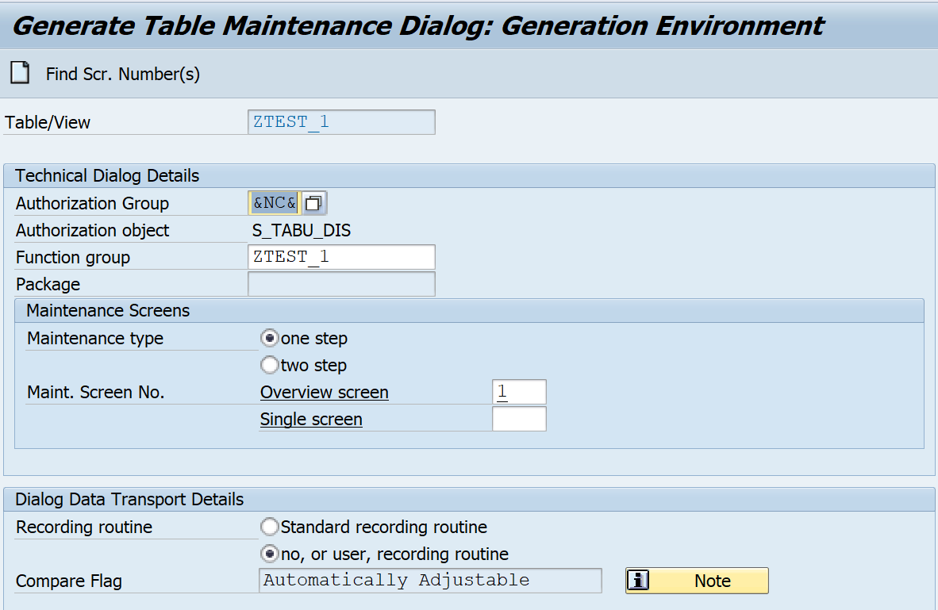
Table Maintenance Generator Environment
TMG Environment
The various objects of TMG
environment are as follows:
Authorization Group
Function Group
Maintenance type
Maintenance Screen No.

Slide 10
Table Maintenance Generator Environment(Contd.)
Authorization Group : It is used to specify the users who are authorized to maintain table or view contents. If a table is maintained by a group of people, an authorization group is assigned else fill the option ‘&NC&’.
Function Group : Here, the name of the function group can be same as that of table/view.

Slide 11
Table Maintenance Generator Environment(Contd.)
Maintenance type - One step and two step. In case of one step only overview screen is applicable. In case of two step, both overview screen and single screen are applicable.
Maintenance screen No - Overview screen and single screen. In case of one step, a screen number is assigned only to overview screen. In case of two step, a screen number is assigned to both overview screen and single screen.

Slide 12
Important Points for Table Maintenance Generator
To generate the TMG , data browser/table view maintenance options needs to be - display/maintenance allowed.
Whenever we add new columns/fields to the table after generation of TMG, the newly added fields do not appear automatically while maintaining data with the help of SM30.
We need to delete the TMG and generate it again.

Slide 13
Important Points for Table Maintenance Generator(Contd.)
Deleting the TMG never delete the table data.
To delete the TMG, open the table in change mode, otherwise delete button does not appear.

Slide 14
Types of Data in SAP
SAP consists of 3 types of data.
Master data
Transaction data
Configuration data

Slide 15
Types of Data in SAP
Master data - accessed very frequently, but changed very rarely.
Transactional data - can change very often and are not constant.
Configuration data - is that data which we can customize. Customizing depends on the business scenario and customer requirements.

Slide 16
Types of Data in SAP - Example
Suppose there is a company ABC. The example of various types of data in the company ABC are as follows:
Master data - Employee data of the company ABC is the example of master data.
Transaction data - Various transactions in the company like banking transactions, revenue transactions are the examples of transaction data.

Slide 17
Types of Data in SAP - Example(Contd.)
Configuration data - In company ABC, if the employee designation is senior consultant the vehicle allowance is applicable, if the employee designation is other than senior consultant then the vehicle allowance is not applicable. This is one of the example of configuration data.

Slide 18
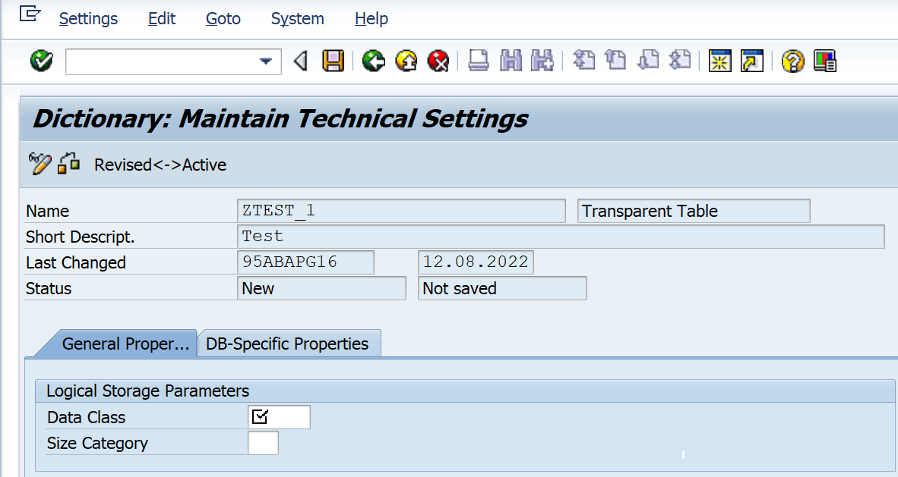
Data Class
Data Class is the part of technical settings
of a table.
Data Class determines in which
portion of the database the
table data is stored.
Technical Settings - Data Class

Slide 19
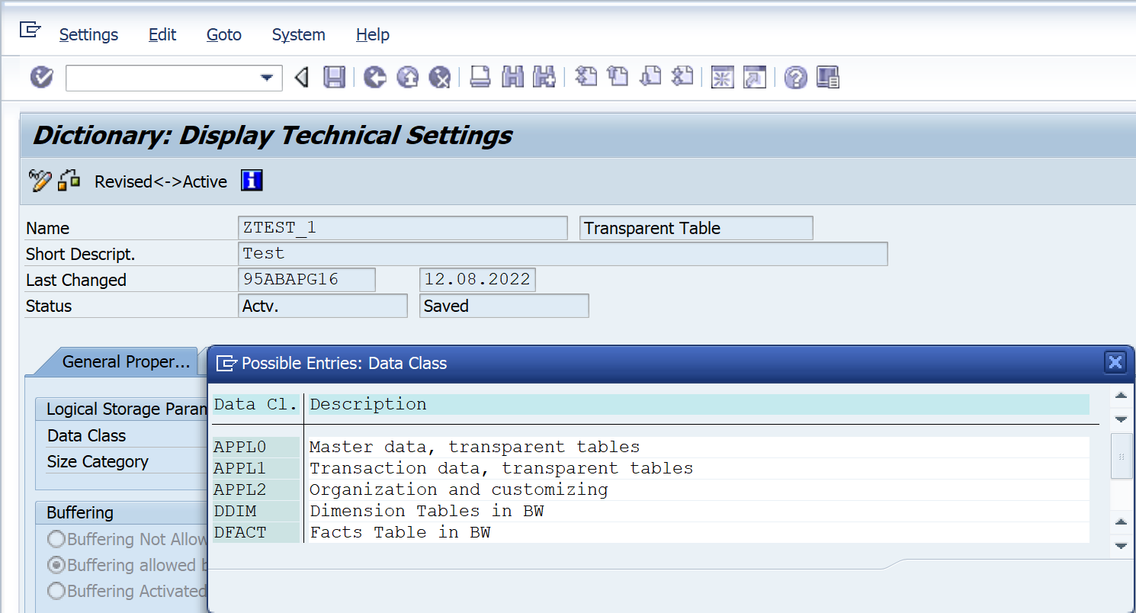
Data Class(Contd.)
The widely used data class are
as follows:
APPL0 - Master data
APPL1 - Transaction data
APPL2 - Configuration data
Various Data Class

Slide 20
Size Category
Size category is also the part of
technical Settings of a table.
The Size category describes the
space requirement of the table
in the database.
Technical Settings - Size Category

Slide 21
Delivery Class
It is the part of delivery and maintenance tab of the table.
It is used for controlling data transport of tables during installation, upgrade and transporting between customer systems.

Slide 22
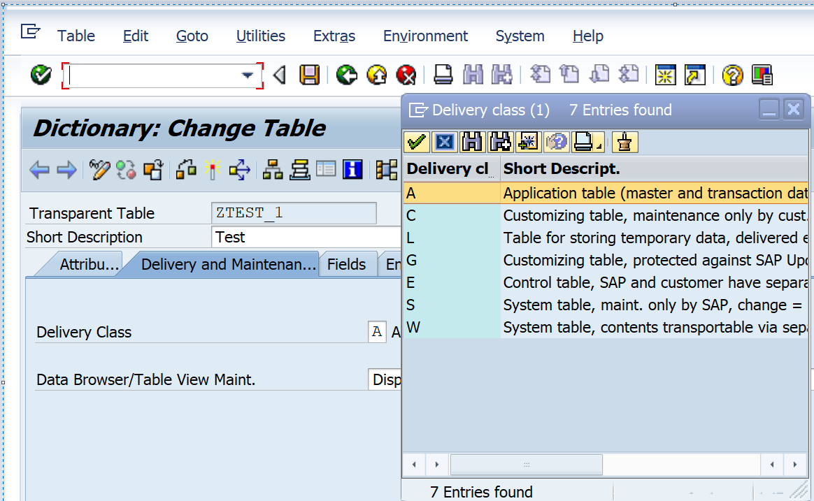
Delivery Class(Contd.)
The widely used delivery class are as
follows:
A - Application table
C - Customizing table
L - Table for storing temporary data
Delivery Class

Slide 23
Data Browser/Table View Maintenance
It is the part of delivery and maintenance tab of the table.
Data browser/table view maintenance specifies whether it is possible to display/maintain a table.

Slide 24
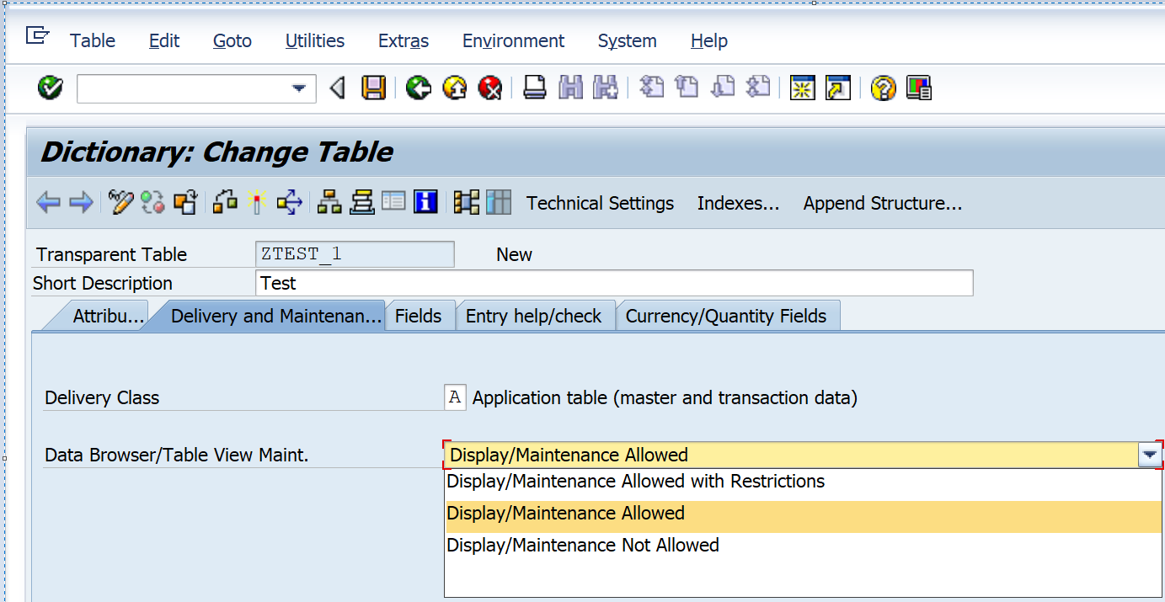
Data Browser/Table View Maintenance Options
Data Browser/ Table View Maint. Options
The various data browser/table view
maintenance options are as follows
Display/Maintenance allowed
Display/Maintenance not allowed
Display/Maintenance allowed with restrictions

Slide 25
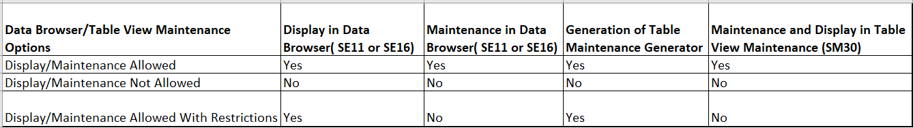
Data Browser/Table View Maintenance Options (Contd.)
Summary of Data Browser/ Table View Maintenance Options

Slide 26
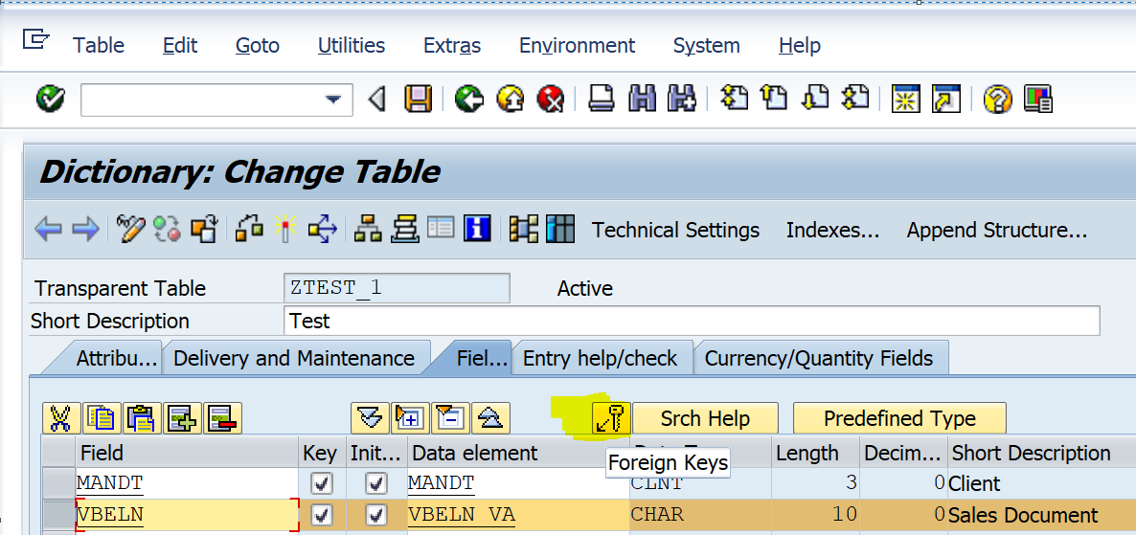
Primary-Foreign Key Relationship
Foreign Keys button in SE11
Primary-Foreign key relationship
is also called as parent-child relationship.
Primary key of one table acts as a
foreign key into another table.
For primary-foreign key relationship tables
must have a common field/column.

Slide 27
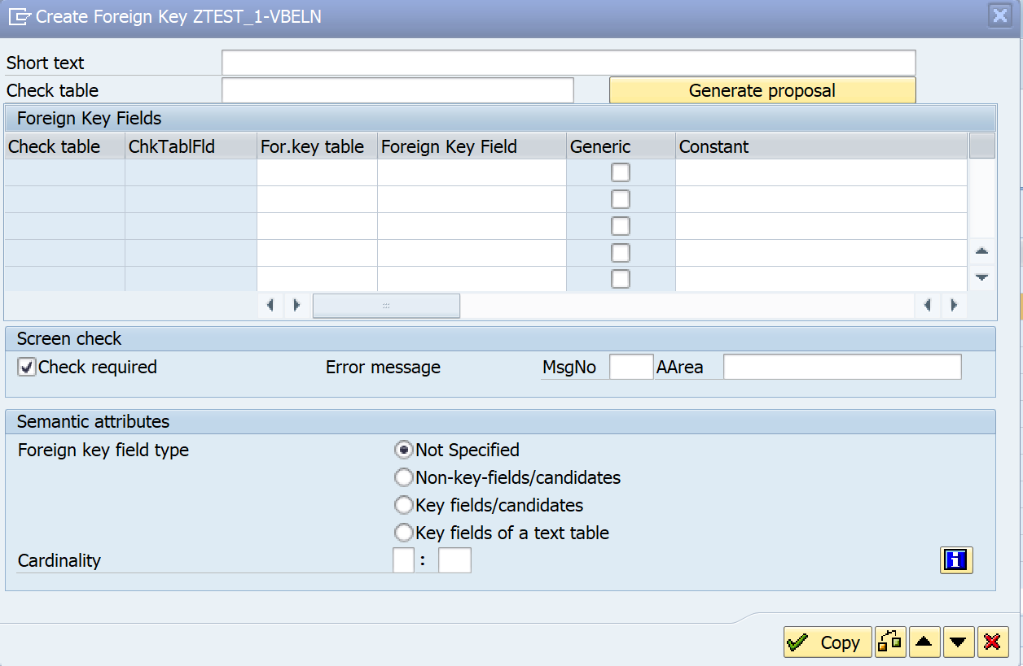
Primary-Foreign Key Relationship(Contd.)
Assigning Primary-Foreign Key Relationship
The purpose of primary-foreign key
relationship is to achieve the
data consistency.
While maintaining the primary-foreign key relationship, we need to pass
the cardinality.

Slide 28
Primary-Foreign Key Relationship(Contd.)
Number of records in one table corresponds to number of records in second table for a particular entry is called as cardinality.

Slide 29
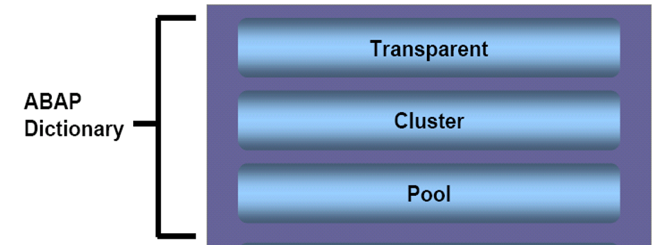
Types of Database Tables
There are 3 types of database tables.
Transparent table
Pooled table
Cluster table
Types of Database Tables

Slide 30
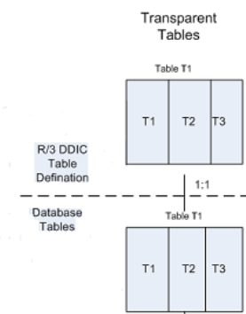
Transparent Table
In case of transparent table, there is 1:1
relationship between the ABAP dictionary
and the database

Slide 31
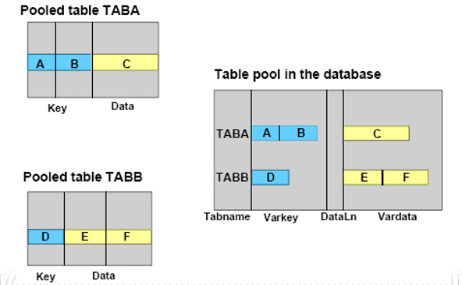
Pooled Table
In case of pooled table, there is N:1(many
to one) relationship between the ABAP
dictionary and the database.
For pooled tables, primary-foreign key
relationship is not required.
Table pool structure - Tabname Varkey Dataln Vardata
Pooled Table

Slide 32
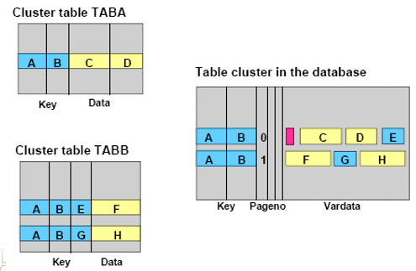
Cluster Table
In case of cluster table, there is N:1(many
to one) relationship between the ABAP
dictionary and the database.
For cluster tables, primary-foreign key
relationship is mandatory.
Table cluster structure - Key Pageno Vardata
Cluster Table

Slide 33
Structures
Structure is collection of fields of same data type or different data type.
There are 2 types of structures in SAP
Include
Append

Slide 34
Include Structure
It is a reusable structure.
We can insert the include structure at any point.
It is applicable to customer specific tables(name starting with Z,Y). It is not applicable to SAP specific tables.

Slide 35
Append Structure
It is not a reusable structure.
It always inserts at the last.
It is applicable to both customer specific tables (name starting with Z,Y) and SAP tables.

Slide 36
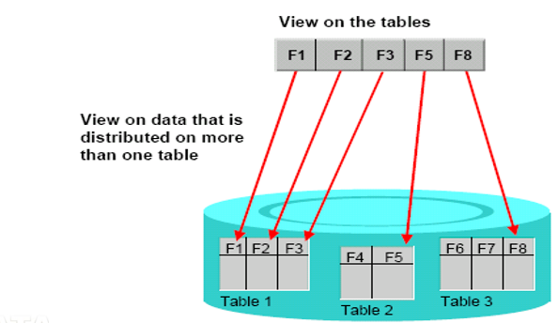
Views
A view is a virtual table.
A view is a logical database.
A view combines the data
distributed in several tables.
The difference between table and view is -
table has data whereas view does not have any data.

Slide 37
Types of Views
There are 4 types of views:
Database view
Projection view
Maintenance view
Help view

Slide 38
Database View
Database view is a collection of one or more database tables.
Database view always implements an inner join.
Pre-requisite : Tables must have a relationship between them.

Slide 39
Projection View
Projection view is applicable for single table.
We take only those fields which are required. It means the data that is actually required is exchanged when the database is accessed.
Projection view is equal to database view, if the database view also contains single table.

Slide 40
Maintenance View
Maintenance view is used to maintain the multiple tables collectively.
Data is entered by the view and then distributed to the tables.
We need to generate the TMG( table maintenance generator) of the maintenance view.
We can maintain the data through transaction code SM30.

Slide 41
Maintenance View(Contd.)
The various pre-requisites of maintenance view are as follows:
Tables must have a relationship between them.
Take MANDT field in the view.
Not more than one record should flow to dependent/secondary table.

Slide 42
Help View
Help view is used in search helps.
In help view contents tab is disabled , but when we use help view in search help, then it display the contents.
The various pre-requisites of help view are as follows:
Tables must have a relationship between them.
Not more than one record should flow to dependent/secondary table.

Slide 43
Indexes
An index can be considered a copy of a database table that has been reduced to certain fields. This copy is always in sorted form.
Sorting provides faster access to the data records of the table.
Index is created to speed up the selection process from database table which helps to achieve good performance.
Index name is 3 characters long.

Slide 44
Indexes(Contd.)
Index stores on the database with the name as tablename~Indexname. Example - table name is ZEMP and index name is Z01, then the index name on the database is ZEMP~Z01.
Disadvantage - Index occupy memory/space on the database.

Slide 45
Types of Indexes
There are 2 types of Indexes:
Primary Index - By default, primary key acts as primary index. This index is created automatically on the database.
Secondary Index - Secondary indexes are created by user on a table in the ABAP dictionary.

Slide 46
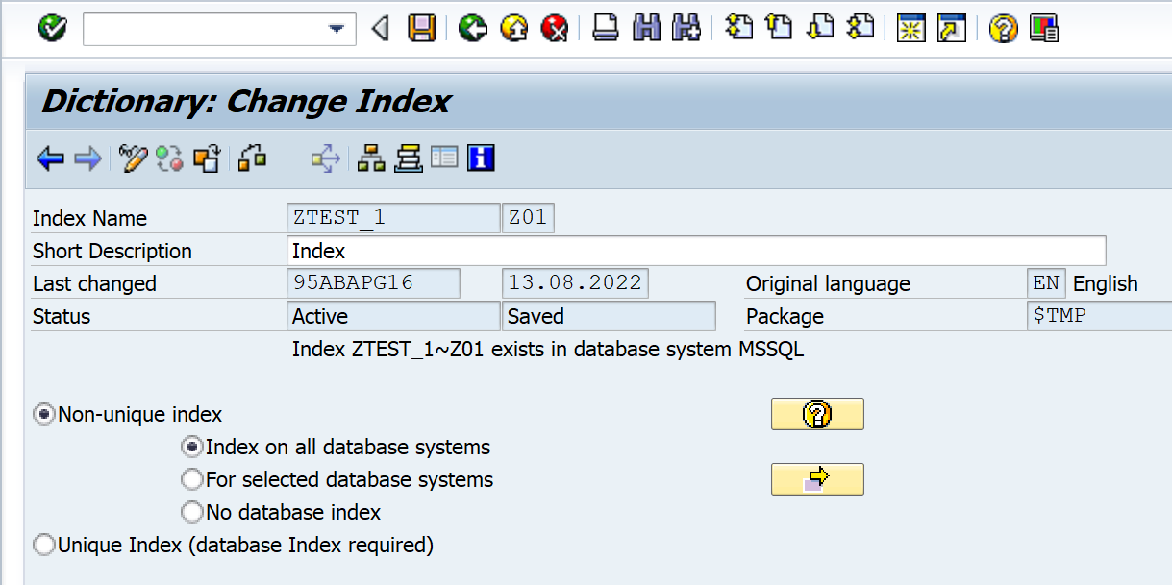
Various options in Non-unique Index
There are 3 options available in non-unique index:
Index on all database systems
For selected database systems
No database index
Various options in Non-unique Index

Slide 47
Various options in Non-unique Index(Contd.)
Index on all database systems - Index is created on all the database systems.
For selected database systems - Index is created on selected database systems.
No database index - Index is removed from the database, but It’s definition still exists.

Slide 48
Search Help
Search help is also called as value help or F4 help.
It provides the various possible values for any input field/column.

Slide 49
Types of Search Help
There are 2 types of search help:
Elementary search help - It is a single search help.
Collective search help - It is a combination of elementary search helps.

Slide 50
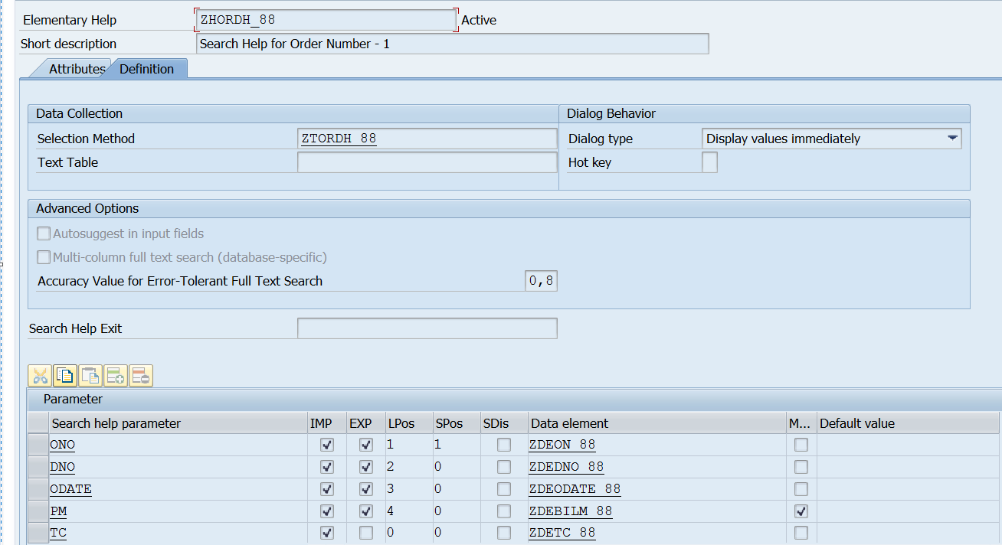
Various options in Search Help
Various options in Search Help
The various options while creating the
search help are as follows:
Selection method
Dialog type
Search help parameter
Import
Export

Slide 51
Various options in Search Help(Contd.)
LPos
SPos
SDi’s
Modified
Default value

Slide 52
Various options in Search Help(Contd.)
Selection method - It is the source of hit list. It is name of the table or name of the view.
Dialog type - It is of 3 types.
Display values immediately - The hit list appears immediately.
Dialog with value restriction - Before displaying the hit list, one restriction pop-up appears.

Slide 53
Various options in Search Help(Contd.)
Dialog depends on set of values - If the hit list has less than 100 entries, it behaves like display values immediately. If the hit list has more than 100 entries, it behaves like dialog with value restriction.
Search help parameter - Parameters which we want to include in the search help. They will be used to send and receive values.
Import - Input.
Export - Output. It is used to export the values from the hit list to the screen fields.

Slide 54
Various options in Search Help(Contd.)
SPos - Screen position. It is the position of parameters on the dialog box.
LPos - List position. It is the position of parameters on the hit list.
SDI’s - Its purpose is to make search help parameters as display(read) only.
Modified - The purpose of modified is to change the data element.
Default value - To provide the default value to search help parameter. To provide the default value importing needs to be unticked.

Slide 55
Table Buffering
Buffer is a temporary storage on the application layer.
It improves the performance when accessing the data records contained in the table.
Sometimes, we need to access a particular set of records more frequently than others.
Accessing records directly from a database table can be very time-consuming.
To overcome this drawback, the frequently accessed records of a table can be placed in a buffer from which they can be accessed easily.

Slide 56
Buffering Options
Table buffering is the part of technical settings of the table.
The various buffering options are as follows:
Buffering not allowed - Table buffering is not performed for the table.
Buffering switched on - Table buffering is performed for the table.
Buffering allowed, but switched off - Buffer is allowed but it is switched off and can be switched on anytime according to the requirement of customer.

Slide 57
Types of Table Buffering
There are 3 types of table buffering:
Single record buffering
Full buffering
Generic area buffering

Slide 58
Single Record Buffering
In case of single record buffering single record loads in the buffer at a time.
When to use - Single record buffering should be used for tables where single records are accessed by specifying the complete key.
Advantage - This type of buffering requires less memory on application layer.
Disadvantage - There is no significant reduction in number of database access.

Slide 59
Full Record Buffering
In case of full buffering full table records load in the buffer.
When to use - Tables that are best suited to full buffering are frequently accessed and rarely changed. A table which stores transaction data should not be opted for full buffering.
Advantage - There is significantly reduction in number of database access.
Disadvantage - This type of buffering requires more memory on application layer.

Slide 60
Generic Area Buffering
In case of generic area buffering the records matches the generic key are loaded in the buffer.
When to use : For generic areas like - language dependent tables.
In case of generic area buffering we need to pass the number of key fields.
The number of key field for a generic area buffering is less than the primary keys of the table.

Slide 61
Important Points for Table Buffering
Whenever we want to stop the buffering of a table , choose the radio button buffering allowed but switched off rather than buffering not allowed.
Never use the transaction code /$TAB to reset the buffer of specific tables, as this transaction code reset the buffer of all the tables. Pass the specific table in AL12 transaction code to reset the buffer. ( Edit - Reset Buffer - Table Buffer ).

Slide 62
Transaction Codes for Table Buffering
Transaction code to check the table buffer : AL12
(Monitor-Buffers-Table Buffer)
The transaction code to reset the table buffer : /$TAB

Slide 63
Lock Objects
The purpose of lock objects is to achieve synchronization.
If multiple users want to change the same data at the same time ,then at a time only one user can change the data.
Lock objects name starts with a prefix ‘E’.
When we want to create customized lock objects, the name must start with EZ or EY.
The transaction code to see the lock entries is SM12.

Slide 64
Lock Modes
There are 3 lock modes:
Read lock.
Write lock.
Enhanced write lock.

Slide 65
Read Lock
Read lock is also called as shared lock.
The default value of read lock is ‘S’.
In case of read lock, other users can display the data, but they can not change the data.

Slide 66
Write Lock
Write lock is also called as exclusive lock.
The default value of write lock is ‘E’.
In case of write lock - other users can not display and change the data.
Write lock can be requested several times from the same transaction and are processed successively.

Slide 67
Enhanced Write Lock
Enhanced Write lock is also called as exclusive lock without cumulation.
The default value of write lock is ‘X’.
In case of enhanced write lock - other users can not display and change the data. Additionally, it protects the further access of the same transaction.
Enhanced Write lock can be requested only once from the same transaction and can not be processed successively.

Slide 68
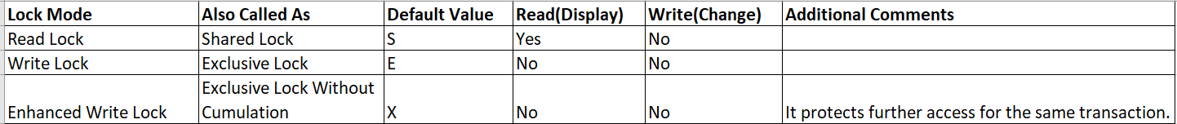
Lock Modes Summary
The summary of various lock modes are as follows :

Slide 69
Lock Object Function Modules
Whenever we activate a lock object, SAP generates 2 function modules. One with ENQUEUE_lock object name and another with DEQUEUE_lock object name.
Example - Suppose lock object name is EZ_VBELN , then the 2 generated function modules are - ENQUEUE_EZ_VBELN , DEQUEUE_EZ_VBELN.
Enqueue function module is used for locking and dequeue function module is used for unlocking.

Slide 70
Table Maintenance Generator(TMG) Events
Event is always triggered by a specific action or a specific occurrence(when a particular time has been reached).
The example of specific actions are mouse click, pressing a key etc. The example of specific occurrence is running out of memory etc.
The same concept of events is applicable to TMG events. Some events trigger by specific user action and some events trigger at specific occurrence.

Slide 71
Table Maintenance Generator(TMG) Events
Depends upon the requirement, we can add our own custom code using these TMG events.
We can navigate to TMG events through SE11 or SE54 transaction code.
(Utilities-Table Maintenance Generator-Environment-Modification-Events)

Slide 72
Concept of Text Tables
We create text tables, when we want to store explanatory text in multiple languages.
It is not advisable to store the texts in primary key table.
The text table has the key fields of primary table and must have an additional language field.
In the primary key table, we can check the text in logon language for the non-key fields of text table.
In text table, we can check the text in all the languages.

Slide 73
Check Table and Value Table - Check Table
Check table works at field level.
Check table checks the field values or restrict the field values.
When a field has a check table, the set of all possible entries to the field is defined by the contents of this check table.
The contents of the check table are therefore offered automatically in the input help.

Slide 74
Check Table and Value Table - Value Table
Value table works at domain level.
When we need the table fields referring to a domain should be checked against a certain table, we define a value table in the domain.
When we enter a value table, the system can make a proposal and a value table becomes a check table when a foreign key is defined.

Slide 75
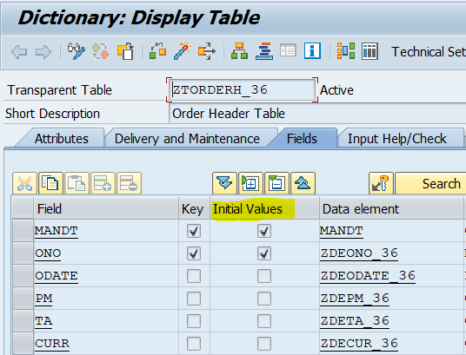
Concept of Initial Values Checkbox in Tables
We can select the checkbox Initial values
for table fields, then the type dependent
NOT NULL value be assigned to that field
and the flag for NOT NULL is set to true on
database.
Initial Values Checkbox in Tables

Slide 76
Concept of Initial Values Checkbox in Tables(Contd.)
Many databases, by default initialize the value of a field as NOT NULL even if the initial value checkbox is not ticked.
The Path to check the Initial values of a field is : Utilities-Database object-Display.

Slide 77
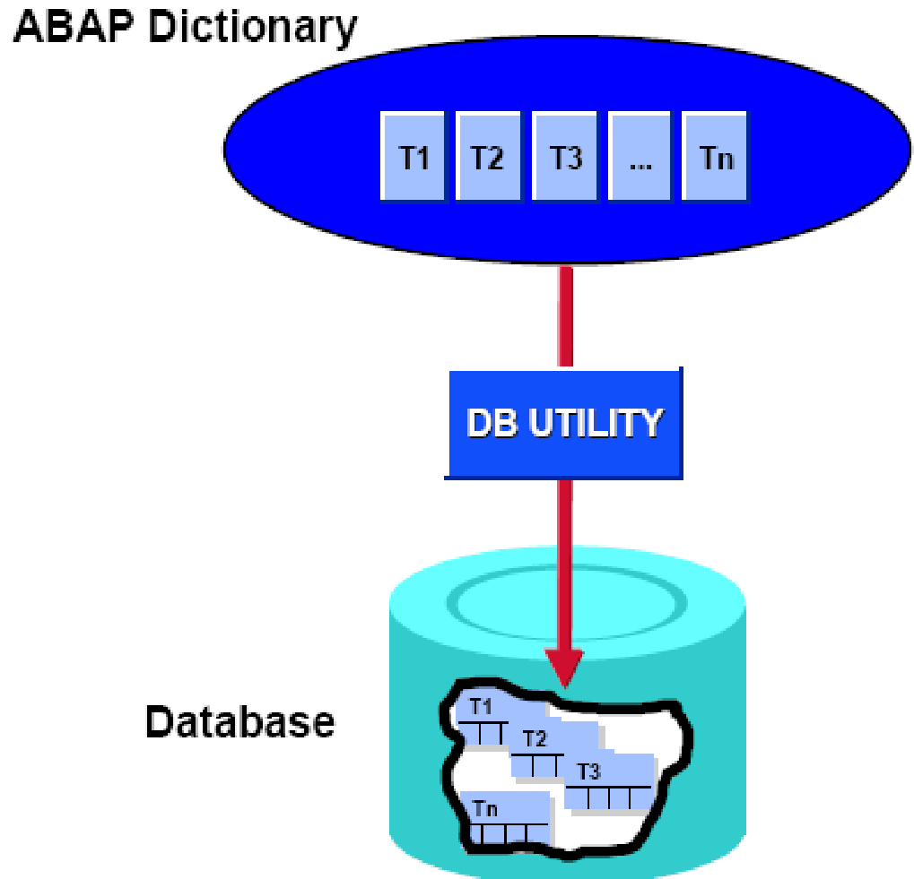
Database Utility
The database Utility acts as a interface
between the ABAP dictionary and the database.
The database utility allows you to edit database objects.
The transaction code for database utility is SE14.
Precaution : Do not perform any database operation
on the table while performing the database utility.
Database Utility

Slide 78
Important Transaction Codes
SE11 - Transaction code for Data Dictionary
SE16 - Transaction code for Data Browser
SE16N - Transaction code for New Data Browser
SE14 - Transaction code for Database Utility
SM12 - Transaction code for Lock Entries

Slide 79
Thank You

